Slide 1
Part 3: Network Meta-analysis and application
11 May 2017

Slide 2
Objectives
Understand the purpose of a network meta-analysis
Write the basic code for a network meta-analysis
Perform a network meta-analysis
Extract the results of the posterior distribution and apply it to a cost-utility analysis Markov model
Compare the results of a parameter that is informed by Bayesian NMA versus a predefined distribution

Slide 3
Background
Crohn’s disease is a chronic relapsing bowel disease with an incidence rate of 7.9 cases per 100,000 (1999-2000) and prevalence of 174 per 100,000 (2001)
To date, there are no direct comparisons of biologics for Crohn’s disease
A Markov model was constructed to evaluate the cost-effectiveness of biologics in Crohn’s disease
A network meta-analysis was used to inform the probability of transition from a moderate-to-severe state to a remission state

Slide 4
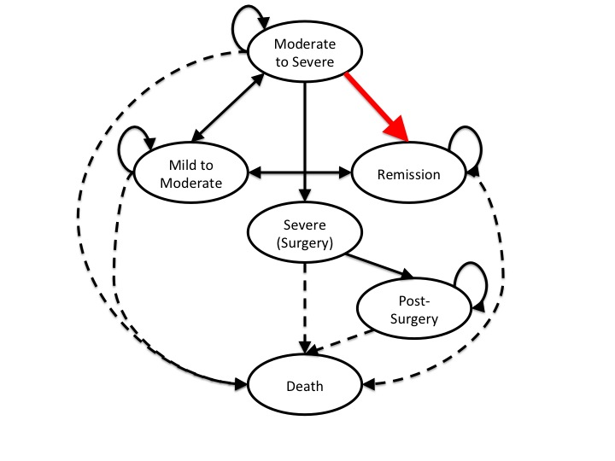
Markov model for Crohn’s disease

Slide 5
Evidence synthesis
Transition probability: Moderate-to-Severe → Remission
Perform a network meta-analysis to generate the value for this parameter (tp mod-rem)
Generate a table of the posterior samples and use that for the CUA

Slide 6
Network meta-analysis
IFX
ADA
Placebo
CTZ
VED

Slide 7
Biologics
This is an NMA of biologics for Crohn’s disease. There are 10 studies with 6 groups. They are grouped as:
1 = Placebo
2 = Infliximab (IFX)
3 = Adalimumab (ADA)
4 = Certolizumab (CTZ)
5 = Vedolizumab (VED)

Slide 8
NMA
Model
Initial values
Priors

Slide 9
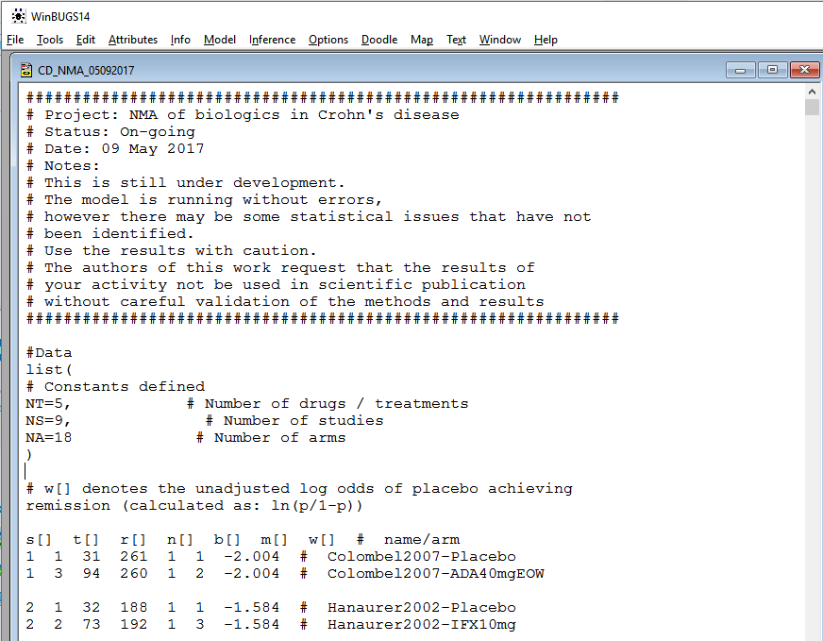
WinBUGS example

Slide 10
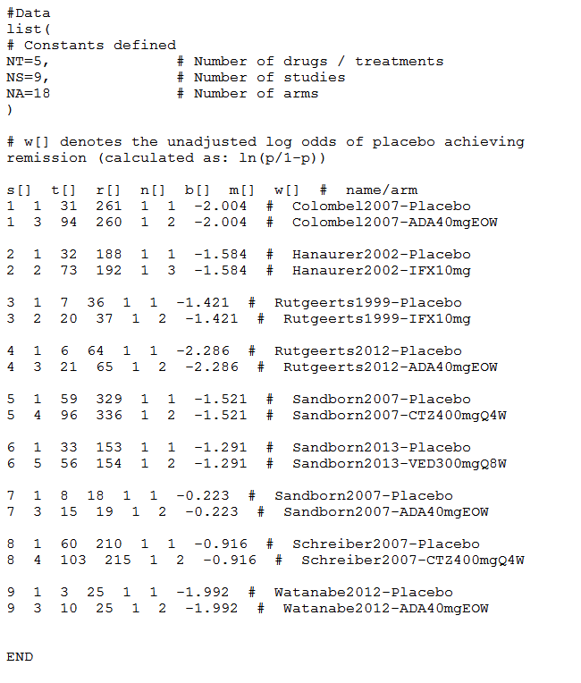
Data

Slide 11
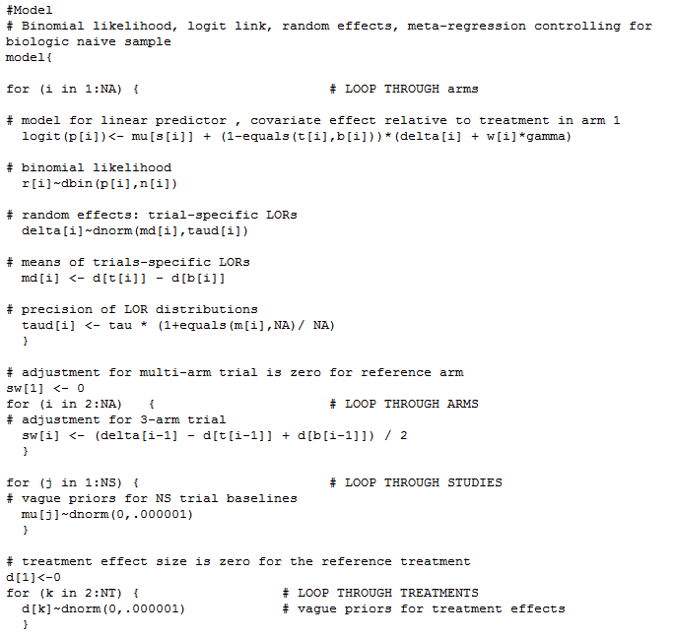
Model

Slide 12
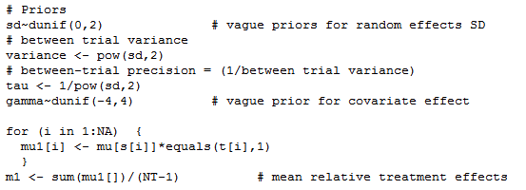
Model (2)

Slide 13
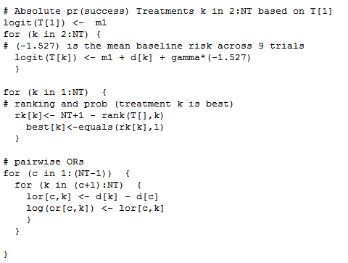
Model (3)

Slide 14
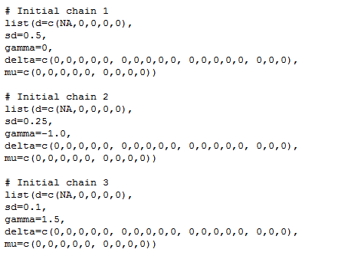
Model (4)

Slide 15
WinBUGS example
Installer and patch are located here:
https://www.dropbox.com/sh/ml6gp0numbayge9/AABBYwFYzgVcTObW5jvYAM_Ea?dl=0
First, install Wine
Second, open Wine
Third, locate WinBUGS.exe and execute
Fourth, patch WinBUGS
Fifth, crack WinBUGS

Slide 16
CUA Results
Strategy | QALYs | Costs
Infliximab | 26.22 | $241,300
Adalimumab | 26.21 | $292,400
Certolizumab | 26.19 | $393,500
Vedolizumab | 26.20 | $295,900
Placebo | 17.72 | $167,800

Slide 17
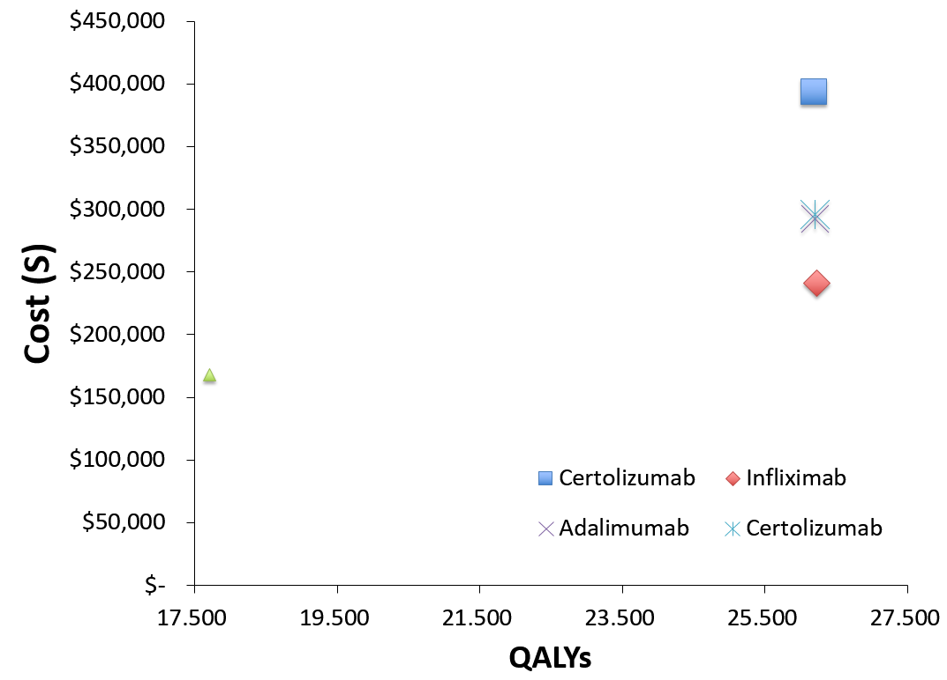
CUA – CE Plane

Slide 18
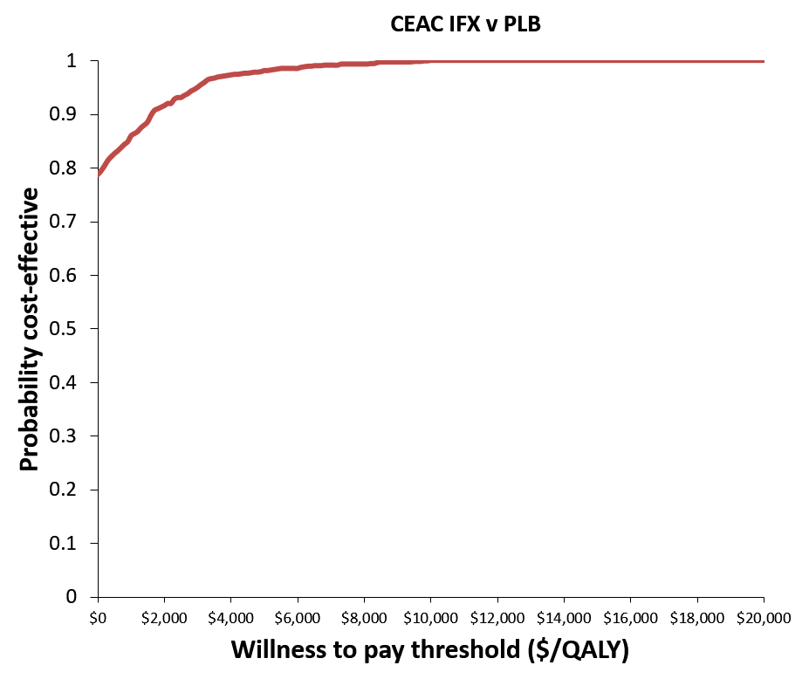
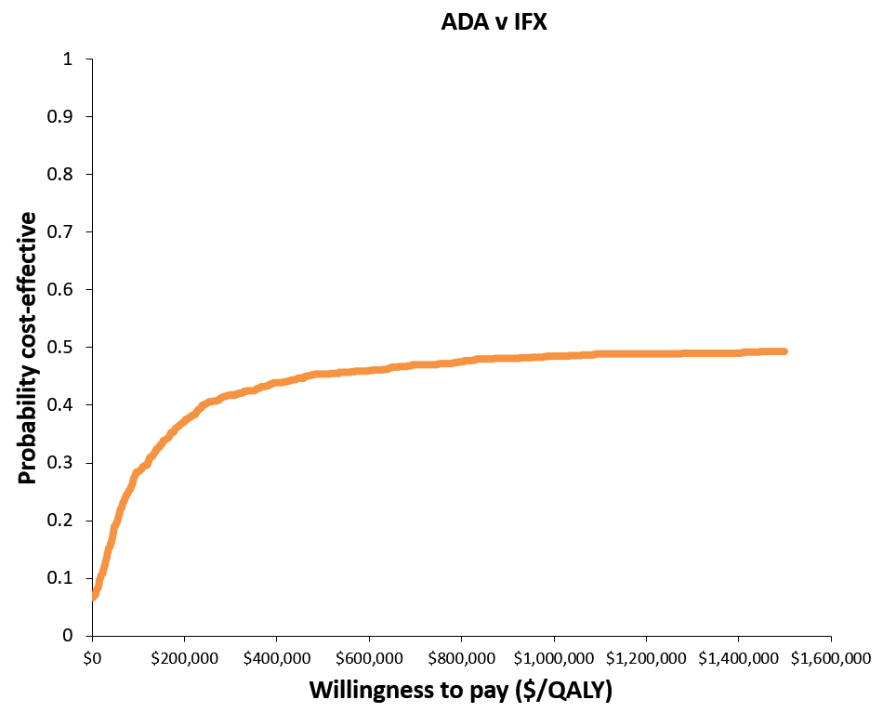
CUA - CEAC

Slide 19
CUA Comparison between beta distribution and inputted values
Inputted values
Beta distribution
Strategy | QALYs | Costs
Infliximab | 26.22 | $241,300
Adalimumab | 26.21 | $292,400
Certolizumab | 26.19 | $393,500
Vedolizumab | 26.20 | $295,900
Placebo | 17.72 | $167,800
Strategy | QALYs | Costs
Infliximab | 26.19 | $212,900
Adalimumab | 26.22 | $304,000
Certolizumab | 26.31 | $529,200
Vedolizumab | 26.16 | $249,700
Placebo | 17.70 | $153,000

Slide 20
Other software / portals
RJAGS
https://github.com/cran/rjags
https://sourceforge.net/projects/mcmc-jags/files/rjags/

Slide 21
ADDIS 2.0
https://drugis.org/software/addis2/index

Slide 22
ADDIS 2.0—Relative effects

Slide 23
ADDIS 2.0 – Forest plot

